Slide 1
Analytics
Salil Mehta
2014

Slide 2
Statistics: Course logistics
In-class problems about once every 90 minutes. If you ever need to take a quick unscheduled mental break, please let me know and we can take one soon thereafter.
Bring a spreadsheet software to class. But a calculator is also good, preferably one with statistics functions (e.g., Σx, Σx², n, etc.) Software such as R, and/or Python will be used.
Grading is based on full participation and attendance, in addition to any other quizzes.
Supplementary reading and course material can be found at statisticalideas.blogspot.com, and a paper draft of the book “Topics in statistics” can optionally be e-mailed out for specific chapters.
The lecture slides here are by themselves, however, sufficient to get through the course.
Class is meant to be interactive so speak up often in terms of what is making sense and what needs to be reviewed again.
Encourage –today if possible- submitting other statistical problems you are thinking about or have recently experienced.
Instead of online, also encourage contact me anytime with questions:
Cell phone number provided in class, or mehta@post.harvard.edu
Any questions now, before we go into the syllabus?

Slide 3
Statistics: Course syllabus
Section 1
Logistics (just completed that), and Introduction
Data collection considerations
Descriptive statistics, with R module
Section 2
Confidence intervals, with Python module
Section 3
Hypothesis testing, with Python module
Section 4
Regression (and correlation, and causation), with R module
Multivariate regression, and Intro clustering, with R module
Conclusion

Slide 4
Introduction: types of decisions that use statistics and analytics
Examples
If and when a new electric car or a new light bulb will fail.
Portion of new mortgage loans that will default.
Amount of liquid to pour into a container at a manufacturing plant, such that 90% of the time we are within 10% of a quality requirement.
Likelihood of finding coal under a plot of land.
Analysis of a drug benefit.
Assessing the relationship between a technologies use and overall productivity.
Analysis of financial market time series relationships.
The likelihood of large deviations on customer selection, versus the current product mix.
Whether a passenger who is found to have carried liquids in his/her carry-on did so intentionally or was simply an accident.
So there are many different ways statistics are used in industry. What are some problems that are not inherently statistics oriented? Here the list is also large, for example:
The dispersion of dividends to all preferred shareholders.
The set-up of tomorrow’s periodic table.
The year a now bankrupt company had filed Chapter 7.
The goal of statistics -as we learn it in this course- is to know the tools and rules of thumbs, which can inform smarter decisions.

Slide 5
Data collection: Some questions to consider
The most important question to ask is “what is the problem we are trying to solve?”
This means in great detail, one should initially write out what the output should look like.
After this initial question we should ask:
What is the data measuring?
Is one looking at a sample, or the entire population?
What adjustments were or should be made to the raw data?
Are there missing data? Is the sample representative?
Is the sample statistically significant?
Is the amplitude of any signal more important than the direction (e.g., Challenger results)?
Do the data attributes align?
Have outliers been examined for data quality issues?
Could the data have been manipulated?

Slide 6
Data collection: Some data types
Primary
Data collected directly for the study in mind.
Secondary
Data that was already collected for a different purpose.
What are the pros and cons of either primary, or secondary data?
Univariate versus multivariate
The probability models studied so far with one variable is univariate. We’ll soon see another that is Amtrak’s top 10 route lengths.
Studying multiple variables as a collection, as we’ll do later in the coursework is multivariate. For two variables, this is termed bivariate.
Other popular bivariate types that we’ll study in the regression analysis section includes cross-section (e.g., state-level, heart disease and stroke in any given year), or a specific time-series (i.e., time generally being the second- and independent- variable).

Slide 7
Data collection: Problem A3 question
One wants to know the historical quarterly return on investment (e.g., P/B ratio) for Johnson & Johnson (JNJ).
So he or she pulls a historical time series that is freely available on the company’s regulatory filings.
What are some of the data collection issues to consider?
We’ll make a list and compare results at the end.

Slide 8
Data collection: Problem A3 solution
One wants to know the historical quarterly return on investment (e.g., P/B ratio) for Johnson and Johnson (JNJ).
What are some of the data collection issues to consider?
Do the market and investment data align in financial sense and in terms of time attribute (e.g., past 4 quarters, prior year, etc.)
Are there any accounting adjustments on both data so they are economically inconsistent?
Are there missing values for periods of loss?
Are there rounding errors for very historic data?
Are there data errors if investments are near zero from either the above, or from the bottom?
If investment data ever revised, which does one need in their data pull? Again this needs to be answered initially, before understanding the data quality of the retrieved data.
Does the company ever replace actual investment data with forecasted estimates for other purposes?
Is the entire JNJ data history available?
Could other definitions of return or of investments make sense (e.g., successful number of Phase 3 trials, headcount, etc)?
If one needs other variables to go along with P/B would they be compatible?
Are there scaling errors in the data history (e.g., dollars instead of cents in some cases)

Slide 9
Descriptive statistics: Definition
Data analysis is done so that we can describe the situation from which the data was drawn.
This topic is of greater importance with the emergence of Big Data problems.
The objective is to present or interpret the information clearly.
For example, the current weather map in the news.
Inferential statistics, on the other hand, makes broader inferences about the population based on an underlying sample.
For example, if the daily Washington weather data for two weeks ago becomes missing, how could one understand the “population” that represents this reference week?

Slide 10
Descriptive statistics: Definition, cont’d.
Often people get confused between which of the two they are performing and therefore use inappropriate techniques to arrive at inadequate results.
For example, assuming a small sample reflects the theoretical distribution.
Or making comments about the chance of something happening in a small sample, based on a model. Such as suggesting it is just as likely to flip 2H and 2T as it is to flip 4H and 4T.
Now that we have some set-up for what descriptive statistics means, let’s look at some cases for both qualitative and quantitative data.

Slide 11
Descriptive statistics: What share of Vitamin C bottles are sold?
Sales data:
Bottles with Vitamin C 500
Bottles with Vitamin D 500
? 500
Grand total of bottles sold 1250

Slide 12
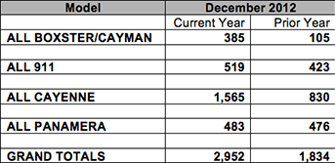
Descriptive statistics: sometimes data are qualitative (here it’s car models)
We can have an experiment where the results are uncertain but we know all possible outcome in the sample space.
For example, last December (known as December 2012 as current year) approximately a dozen Porsches were sold per store hour in North America.
Assuming the same quantity and mix of cars is sold in 2013, what is the distribution of Porsche models sold in December 2013?
The sales results up to “Grand total” are from Posche’s financial statements are MECE (categories are mutually exclusive and completely exhaustive)

Slide 13
Descriptive statistics: MECE categories easily morph into relative distributions
With the success of Cayenne, are too much resources going into the 911 and Panamera?

Slide 14
Descriptive statistics: example of looking at quant data (e.g., route mi.)
Name | Route miles (rounded to nearest 10 miles)
Northeast Regional | 660
Acela Express | 460
Pacific Surfliner | 350
Capitol Corridor | 170
Keystone Service | 200
San Joaquins | 300
Empire Service | 460
Amtrak Cascades | 470
Hiawatha Service | 90
Empire Builder | 2230

Slide 15
Descriptive statistics: a visual (tool) is needed but doesn’t show everything.

Slide 16
Descriptive statistics? Which central tendency, & which dispersion is ~100?
210
-36
2
142
225
70
161
183
-75
118

Slide 17
Descriptive statistics: a visual is needed but doesn’t show everything.
Looking at previous slides, see if which one is easier to assess (and what would be the values for each?)
Average (write this down as we will use it in about 5 slides).
Dispersion.
On an aside, the term inclusive versus exclusive for a data range is described as follows, and generally applies to continues data:
(x,y) means the entire range of data up to, but not including y.
(x,y] means the entire range of data up to, and including y.

Slide 18
Descriptive statistics: so grouping numerical data into some bins is better
Route miles | Frequency
(0, 200] | 3
(200, 400] | 2
(400, 600] | 3
(600, 800] | 1
(800, ∞) | 1

Slide 19
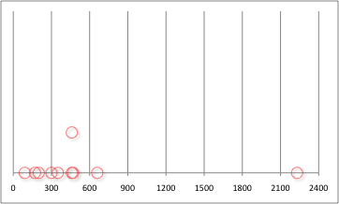
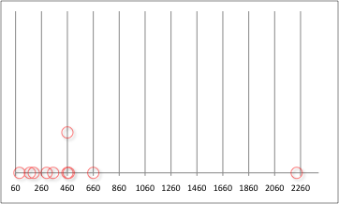
Descriptive statistics: let’s see impact of grouping based on bin choice
(0, 300], (300, 600], etc.
(60, 260], (260, 460], etc.
4 4 1 1 (for 900+) 3 4 2 1 (for 660+)

Slide 20
Descriptive statistics: A variety of measures to analyze the statistics
Notice why bin size matters? What if we picked 300 instead of 200?
Measures that focuses on describing characteristics of the data:
Mean (or average)
Median
Mode (multiple modes can exist, such as bimodal, trimodal, etc.)
Dispersion (standard deviation, variance, range, MAD, CV, IQR)
The general shape (e.g., the typical location of any modes)
Outliers
And relationships within data (when applicable):
Differences across time (e.g., in moving averages, or standard deviations)
And relationships between data (when applicable):
Differences among groups
Correlation
ρ²
Regression slope

Slide 21
Descriptive statistics: Problem 3 questions
Examine the 2012 automotive production statistics from International Organization of Motor Vehicle Manufacturers (OICA).
Is the data here qualitative or quantitative?
What was the total number of commercial vehicles produced?
How many cars were made in North America (NA)?
In NA were there more cars or more commercial vehicles, which were produced?
All of these questions can be answered from the data on the right.
Cars (MECE)
U.S.A., 4.1m
Canada, 1.0m
Mexico, 1.8m
Major NNA* countries, 55.8m
“Other”, 0.4m
Commercial vehicles
Major NNA* countries, 12.2m
“Other”, 0.1m
Total vehicles
Cars+Commercial, 84.1m
*NNA = non-North America

Slide 22
Descriptive statistics: Problem 3 solutions
Focus on geographic regions, imply qualitative data.
What was the total number of commercial vehicles produced?
Create a table or diagram if necessary to determine gaps.
84.1-(4.1+1.0+1.8+55.8+0.4) = 21.2m
How many cars were made in North America (NA)?
Unknown since “Other” is not defined and can include some part NA vehicles.
In NA were there more cars or more commercial vehicles produced?
Cars
= 4.1+1.0+1.8+(0,0.4) < 7.3m
Commercial vehicles
= 21.2-12.2-(0,0.1) > 8.9m
Cars (MECE)
U.S.A., 4.1m
Canada, 1.0m
Mexico, 1.8m
Major NNA* countries, 55.8m
“Other”, 0.4m
Commercial vehicles
Major NNA* countries, 12.2m
“Other”, 0.1m
Total vehicles
Cars+Commercial, 84.1m
*NNA = non-North America

Slide 23
Descriptive statistics: Focus on central tendency
Revisiting the train route data, and then sorting it.
The histogram data from before shows a central value of just under 400
Mean (or average)
= Σx_{i}/n = 5390/10 = 539
Median
= x_{(n+1)/2} = x_{5.5} = 405
Mode
= x value with max frequency
= 460 has frequency of 2
Rank. Name | Route miles (rounded to nearest 10 miles)
1. Hiawatha Service | 90
2. Capitol Corridor | 170
3. Keystone Service | 200
4. San Joaquins | 300
5. Pacific Surfliner | 350
6. Acela Express | 460
7. Empire Service | 460
8. Amtrak Cascades | 470
9. Northeast Regional | 660
10.Empire Builder | 2230

Slide 24
Descriptive statistics: Focus on central tendency
Revisiting the train route data, and then sorting it.
The histogram data from before shows a central value of just under 400
Mean (or average)
= Σx_{i}/n = 5390/10 = 539
Median
= x_{(n+1)/2} = x_{5.5} = 405
Mode
= x value with max frequency
= 460 has frequency of 2
All central values above are within (data) range of 90 and 2230.
Rank. Name | Route miles (rounded to nearest 10 miles)
1. Hiawatha Service | 90
2. Capitol Corridor | 170
3. Keystone Service | 200
4. San Joaquins | 300
5. Pacific Surfliner | 350
6. Acela Express | 460
7. Empire Service | 460
8. Amtrak Cascades | 470
9. Northeast Regional | 660
10.Empire Builder | 2230

Slide 25
Descriptive statistics: Most popular dispersion formulas
Staying with train route data.
The histogram data shows typical spread of +200 of the 539 average
Sample variance (s²)
= Σ(x_{i-}-x_{average})²/(n-1)
= 3.44m/9 = 382,000
Keep in mind the variance of a sample is s², while for the population it is σ².
Sample standard deviation (s)
= √(s²) = √382,000 = 618
Unlike with the mean, the sample statistics above are biased from the less the full population sample. Hence we use n-1 instead of n.
Also the standard deviation is always less than the range:
Range = x_{max}-x_{min} = 2230-90 = 2140
Does anyone know why standard deviation < range?
Route miles | Difference with route average | (Difference with route average)²
90 | -449 | 201,601
170 | -369 | 136,161
200 | -339 | 114,921
300 | -239 | 57,121
350 | -189 | 35,721
460 | -79 | 6,241
460 | -79 | 6,241
470 | -69 | 4,761
660 | 121 | 14,641
2230 | 1,691 | 2,859,481

Slide 26
Descriptive statistics: Additional dispersion formulas
Staying with train route data.
Mean absolute deviation (MAD) is less than biased standard deviation
= Σ|x_{i}-x_{average}|/n
= 3624/10 = 362
Does anyone know why MAD < s?
Coefficient of variation (CV) looks at spread relative to the average
= s/x_{average} = 618/539 = 1.1
The IQR is Q₃-Q₁
= 75th percentile – 25th percentile
= x_{.75(n+1)} –x_{.25(n+1)} = x_{8.25} –x_{2.75}
= 518-193 = 325 (Excel errs w/243)
IQR is most insensitive to outliers, as we see it is less than even MAD.
So generally IQR<MAD<σ<s<range
Route miles | Absolute difference with route average
90 | -449 → 449
170 | -369 → 369
200 | -339 → 339
300 | -239 → 239
350 | -189 → 189
460 | -79 → 79
460 | -79 → 79
470 | -69 → 69
660 | 121 → 121
2230 | 1,691 → 1,691

Slide 27
Descriptive statistics: Fraction within IQR, and 1, and 2 s for route miles
Sample: {90,170,200,300,350, 460,460,470,660,2230}
From (193,518]?
6 (or 60%)
Within +618 of 539?
9 (or 90%)
Within +628*2 of 539?
9 (or 90%)
Weren’t these questions easier when we show the data sorted?

Slide 28
Descriptive statistics: Problem 4 questions
Staying with train route data.
What would the largest route mileage in this series of 10 values need to be to make the mean equal the median?
What would be the MAD be, in such case?
What would be the s be, in such case?
Route miles | Absolute difference with average | Relative difference with average
90
170
200
300
350
460
460
470
660
?

Slide 29
Descriptive statistics: Problem 4 solutions
What would the largest route mileage in this series of 10 values need to be to make the mean equal the median?
405 = Σx_{i}/10
4050 = Σx_{i} = 3160+x₁₀
What would be the MAD be, in such case?
= Σ|x_{i}-405|/10
= 1830/10 = 183
What would be the s, in such case?
= √[Σ(x_{i-}-405)²/9]
= √[Σ|x_{i}-405|²/9]
= √[521,000/9] = 241
As a subtle algebraic point if x²=y², then √(x²)=√(y²). Even if latter holds, x doesn’t have to equal y. The x could be equal to –y. Additionally, √(x²) does not equal x, but rather +x.
Route miles | Absolute difference with average | (Difference with average)²
90 | 315 | 99,225
170 | 235 | 55,225
200 | 205 | 42,025
300 | 105 | 11,025
350 | 55 | 3,025
460 | 55 | 3,025
460 | 55 | 3,025
470 | 65 | 4,225
660 | 255 | 65,025
x₁₀ = 890 | 485 | 235,225

Slide 30
Descriptive statistics: Computer section
Go to the following web portal:
https://sites.google.com/site/statisticalideas/home/courses/georgetown-analytics
Upload the Amtrak route miles file into R, titled “Amtrak20140421.txt”.
Calculate the average, and median of these Amtrak top 10 route miles.
Also calculate the sample standard deviation (s), as well as determine the sample range.

Slide 31
Descriptive statistics: Additional terms
Deciles:
Similar to last digit of zipcode example (particularly because it was the population as opposed to the top 10 route example done earlier).
They are generally 10 evenly spaced (and equally sized) fractional portions of sorted data. These are therefore ratio units parameterized by an open 0 at the low end, and a closed 10 at the high end.
Percentiles:
Similar to deciles, except for 100 fractional units instead of 10. The 99th percentile, for example, generally refers to the smallest value that includes at least 99% of the sample.
Similarly, there is no 0th percentile.
We use the term “generally” since the definitions and applications, particularly in actuarial risk, vary slightly.

Slide 32
Descriptive statistics: Publication distributions for top programs

Slide 33
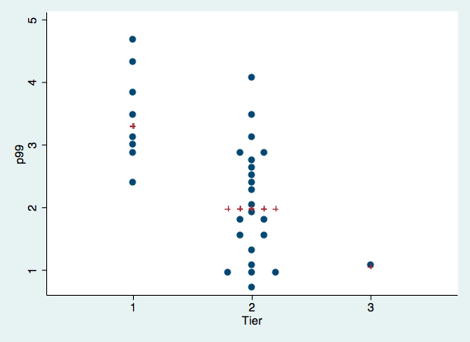
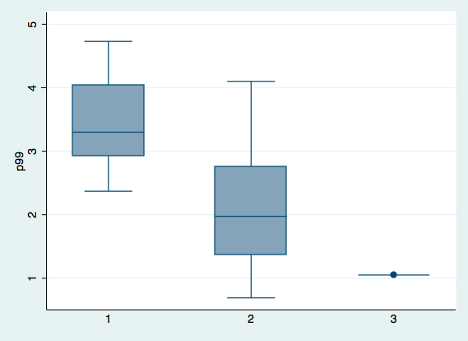
Descriptive statistics: Looking at Tiered dot vs simple box plots for 99%’ilers

Slide 34
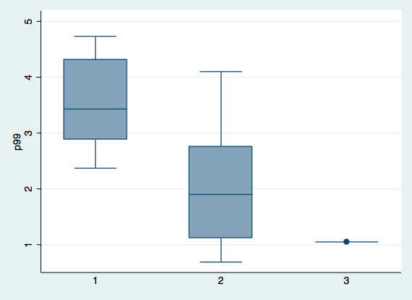
Descriptive statistics: Looking at simple versus weighted box plot distributions

Slide 35
Confidence intervals: The roots in probability
Say a brick manufacturer produces bricks that typically weigh 5.0 pounds.
Let’s also state that the manufacturing process is somewhat random, continuously distributed, and mound-shaped, and has a typical standard deviation on the brick’s weight of 1.0 pound.
What is the exact probability that if you see a brick, it’s weight is 5.5 pounds?
What is the approximate probability that if you see a brick, it’s weight is greater than 5.5 pounds?
On the other hand, what is the approximate probability that if you sample 30 bricks, the typical brick’s weight is greater than 5.1 pounds?
15%
30%
50%
75%
None of the above
Are the answers different, to these two questions immediately above?

Slide 36
Confidence intervals: Theoretical sample for 30 count
Sample mean is expected to equal the population mean of 5.0 pounds:
Standard deviation of sample mean is:
σ_{sample mean} = σ/√n
= 1/√30
= 0.2 pounds
So the probability that the sample mean is greater than 5.1 pounds is 1-P(z).
Where z is (5.1-5.0)/0.2, or ½. And the probability is 29%

Slide 37
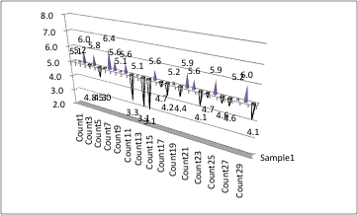
Confidence intervals: 1 sample batch of 30
Sample average is about 5.0 pounds.
This particular sample average shown does not have a distribution (it’s just one batch’s results). It is always fixed at some level of about 5.0 pounds.
Sample standard deviation (~σ) is 1.1 pounds.

Slide 38
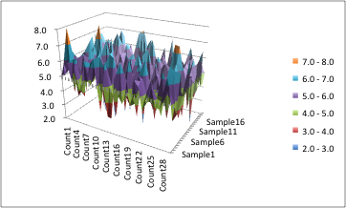
Confidence intervals: 20 batches of 30
All 20 sample averages are each about 5.0 pounds.
What does the probability distribution of those 20 sample averages look like?
Sure they are all about 5.0 pounds, but the distribution these 20 averages makes follows the central limit theorem to some extent.
The 20 sample standard deviations (~σ) are still all 1.1 pounds.

Slide 39
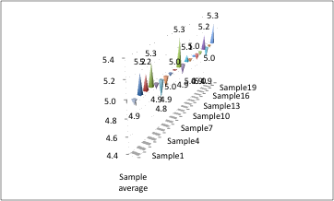
Confidence intervals: 20 sample averages
Average of sample batch averages is of course 5.0 pounds, or μ.
Average of the standard deviation of the batch averages is not always (σ_{individual brick}) 1.0 pounds or the current sample’s (s_{sample average}) of 0.2 pounds. But this is beyond the topics of this course.
The expected value of the standard deviation of individual batch averages (s_{sample average}) is 0.2 pounds in theory.
Which was again equal to the theoretical σ/√n (where n=30) solved earlier.

Slide 40
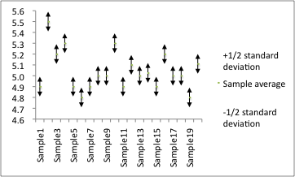
Confidence intervals: 42% conf. the true avg. within ½ s_{sample average (20 batches)}

Slide 41
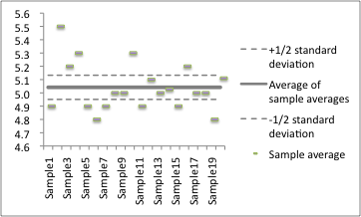
Conf. interval: ~reinterpretation is 42% prob. sample avg. is w/i ½ s_{sample average}

Slide 42
Confidence intervals: 8 reds of 20 w/i ½ s_{sample average}, and 8/20 is about 42%.

Slide 43
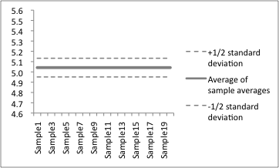
Confidence intervals: 42% confidence true avg. w/i ½ s_{sample avg.} (of 5.04#s)

Slide 44
Confidence intervals: Problem 9
A new health food business wants to imitate the product packaging of a competitive nutritional cereal company, but only knows following guidelines:
A typical box net weight is μ ounces (this is the true weight)
The standard deviation (σ) for a box is 1 ounce.
Unfortunately we don’t know μ, so we send a mystery shopper to the store to purchase 30 boxes of this nutritional cereal product.
The average purchased weight was 19oz (this is the sample weight).
What is the 90% confidence interval of μ?

Slide 45
Confidence intervals: Problem 9 solution
A new health food business wants to imitate the product packaging of a competitive nutiritional cereal company, but only knows following guidelines:
The standard deviation (σ) for a box is 1 ounce.
The average purchased weight was 19oz (this is the sample weight).
What is the 90% confidence interval of μ?
(100%-90%)/2 = 5% tails
The z-score for 95% (100%-5%) is 1.645.
90% = P[z_{95%}] – P[z_{5%}]
= P[1.645] – P[-1.645]
= P[(19-μ_{z95%})/(1/√30)] - P[(19-μ_{z5%})/(1/√30)]
So 90% confidence interval for μ = (18.7, 19.3).

Slide 46
Confidence Intervals: Computer section
Create a Python program that creates 20 batches of 30 samples each.
Each sampled data is a random value, from a normal variable with mean 19, and standard deviation of 1.
For each of the 20 batches, what is the mean? What is the standard deviation among these 20 batches’ means?

Slide 47
Confidence intervals: z-table

Slide 48
Confidence intervals: Problem 9b question and solution
Contrasting t and z statistics
For a sample size of 15, what are the t statistics within 70%, and 95% probabilities?
1.08, 2.15
For a sample size of 30, what are the z statistics within 70%, and 95% probabilities?
1.04, 2.00
Are either the t, or z statistics larger? Provide an explanation as to why.
Sample underestimates dispersion, so s and t balance that out.

Slide 49
Confidence intervals: Proportions (as opposed to averages)
Confidence intervals (CIs) surrounding a mean is different then CIs on proportion’s instead.
In a higher order sense, this is because the proportional probability also provides some information on the standard deviation (σ).

Slide 50
Confidence intervals: Looking into the variance of a Bernoulli trial
If one had an unfair coin that lands on heads (e.g., “100%”), p percent of the time.
The coin therefore lands on tails (e.g., “0%”), 1-p percent of the time. We will create variable for this: q=1-p≠p.
E(X) = p(1) + q(0) = p
E(X²) = p(1²) + q(0²) = p
So for an expected proportion (p), the variance is:
E(X – X_{average})² = E(X²) - E(X)²
= p - p² = p(1-p) = pq
The point here is that the dispersion (variance or standard deviation) is interlinked with p, which itself could vary. It is not in probability theory at a pre-fixed level, such as ½.

Slide 51
Confidence intervals: Visualizing Bernoulli variance http://statisticalideas.blogspot.com/2014/02/bernoulli-dispersions.html

Slide 52
Confidence intervals: Again, from Bernoulli, to binomial
A reminder that a binomial distribution is an independent repetition of identical Bernoulli trials.
In a way similar, but not identical, to the way μ equals the average of sample averages,
Proportion is already like an average,
And hence the true proportion estimated from many trials is also equal to the average of many proportions.
And from central limit theorem, we know that the σ_{p}=√(σ²/n). So this would equal σ_{p}=√(pq/n).

Slide 53
Confidence intervals: Having to estimate σ_{p}
While σ_{p}=√(pq/n), we don’t have the overall binomial σ, nor know the interconnected p or (1-p), or q (else why are we constructing confidence intervals?!),
Hence we need to estimate it.
This estimation uses estimators from the sample trials themselves, assuming a large enough sample:

Slide 54
Confidence intervals: If you estimate σ_{p}, then you have to assume normality
The technique that we used to estimate σ_{p} and then applying a normality assumption is good, and must be only done under two joint circumstances:
The estimated p is near 50%.
The σ_{p} is very small.
The goal here is to leave enough room for the CI so that jointly: most of distribution is mound shaped, and also fully contained and within the portion range of [0,1].
So we can approximate this with the test of whether 0<p+3σ_{p}<1

Slide 55
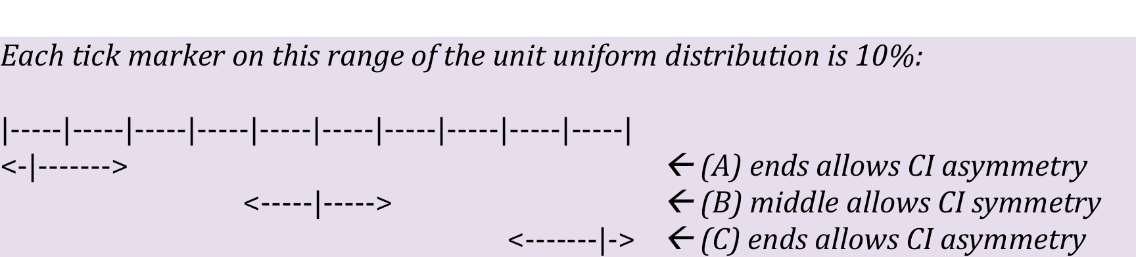
Confidence intervals: Constraints on using symmetrical normal distributions

Slide 56
Confidence intervals: Problem 10 question
A consulting firm wants to know what fraction of their clients would be interested in their new premium add-on service offerings.
Of the firm’s first few sample clients, 2/3 of them accepted the add-on service.
What is the minimal number of clients that the consulting firm would need to sample at this 2/3 rate, in order to 99.5% confident that the add-on would in reality be accepted by at least half their client population?

Slide 57
Confidence intervals: Problem 10 solution
Of the firm’s first few sample clients, 2/3 of them accepted the add-on service.
What is the minimal number of clients that the consulting firm would need to sample at this 2/3 rate, in order to 99.5% confident that the add-on would in reality be accepted by at least half their client population?
1-P[(1/2-2/3)/σ_{p}]=99.5% implies that P[(1/2-2/3)/σ_{p}]=0.5%.
P[(1/2-2/3)/σ_{p}]=0.5% implies that P[(2/3-1/2)/σ_{p}]=99.5%.
If from the z table, we know the score is at least 2.57, then the negative of the score (or -z) is less than -2.57.
In both cases depending slightly on how small the sample size is (e.g., z versus t).
For (1/2-2/3)/σ_{p}=-2.57, σ_{p}=(1/2-2/3)/-2.57=6.5%.
And σ_{p}=√[(2/3)(1/3)/n]=6.5%, so (2/3)(1/3)/0.004~53=n
Notice about how confident (99% range) one needs to be before being able having to consider the σ_{p} approximation, else we have a smaller sample size and lower confidence.

Slide 58
Hypothesis testing: An extension of confidence intervals
Hypothesis testing doesn’t require normal distributions, but that is the most common place from where to start these analysis.
In our confidence interval analysis performed earlier:
We always assume that the sample mean typically equals μ.
This μ is generally, but not always, a known value.
But for this topic however, we perform a statistical hypothesis test concerning this μ,
Given a deviation of an observation (as opposed to from a sample average) from μ.

Slide 59
Hypothesis testing: An example of a test layout
A restaurant owner is is looking at a sample distribution of french fries, that Employee F scoops into each serving container for customers.
The owner expects the container to serve only 1 pound of fries.
However, the average weight the owner gets, from Employee F’s containers, is 1.2 pounds. Note that thus far no sample size or dispersion of results are provided.
So we want to test a hypothesis concerning Employee F, to see if he or she is generally overfilling food into the container (as opposed to the 1.2 pounds coming in more than 1 pound simply by chance).

Slide 60
Hypothesis testing: An example of a test layout, continued
The restaurant owner sets a null hypothesis H₀ that μ<1.0.
This is a null hypothesis of whether Employee F is generally scooping 1 pound or less, or if they are likely overscooping more than 1 pound of fries into the container.
So the parameters of the null hypothesis must be set so that we know that it can be rejected at a certain pre-set level of confidence.
And an alternative hypothesis H_{a} must be established, though at times it is obviously implicit.
For example, H_{a} in this case would be that μ>1.0.
Put differently, if we can’t reject the null hypothesis that Employee F is underfilling the containers (μ<1.0), then we automatically defer to the conclusion that the containers are being overfilled per the alternate hypotehsis.

Slide 61
Hypothesis testing: What does our test look like?
sample average=1.2
?
?
μ=1.0

Slide 62
Hypothesis testing: Establishing a critical score
One needs to ex ante set their statistical standard (e.g, test statistic) for conducting a hypothesis test:
Else one if simply establishing a new critical value after working backwards from a score that fails to reject H₀.
Or switch to a 1-tail, from a 2-tails test.
And neither revisionary testing provides accurate information.
So setting a statistical criteria involves both a percent level, and an a-priori selection of either 1 or 2 tails.
The test should likely be the more rigorous 1-tail test, unless the original test description is of the “H₀=” type (in which case it is likely a 2-tails test).

Slide 63
Hypothesis testing: How statistical manipulation could work (the basics)
In the restaurant example, say the σ_{sample average} is 0.11 pounds.
And the owner originally wanted to just be 95% confident the fries served were 1.0 pounds; neither overserving nor underserving this quantity.
To solve this original test, we use a 2-tails test and therefore have a critical score of 1.96.
And so our sample of 1.2 pounds from Employee F has a test statistic of 1.8 (0.2/0.11). So we fail to reject the original H₀, which is that the fries are equal to 1.0 pounds.
The owner now “could” with little effort disingenuously manipulate the test to achieve a significant result:
Just change to a 1-tail test, thereby lowering the critical score to 1.65, thus able to reject H₀.
Or change from seeking a 95% confidence, to seeking a 90% confidence, which also happens to lower the critical score lowers to 1.65. Thereby allowing the owner to reject H₀.
Or some combination of both ideas above.
Hence to avoid any incredulous reporting interpretations of findings, we require a policy that the critical level (generally α, or 1-confidence level) and selection of 1 or 2 tails be documented just once, and in advance.

Slide 64
Hypothesis testing: 1 and 2 tails table
Level | 1-tail α | 2-tails α/2 | 1-tail z_{α} | 2-tails z_{α/2}
90% | 10% | 5% | 1.28 | 1.65
95% | 5% | 2.5% | 1.65 | 1.96
99% | 1% | 0.5% | 2.33 | 2.58

Slide 65
Hypothesis testing: Directions for statistical manipulation
Level | 1-tail α | 2-tails α/2 | 1-tail z_{α} | 2-tails z_{α/2}
90% | 10% | 5% | 1.28 | 1.65
95% | 5% | 2.5% | 1.65 | 1.96
99% | 1% | 0.5% | 2.33 | 2.58

Slide 66
Hypothesis testing: Problem 11 question
An “optimal” laptop lifetime for the industry is four years:
If the lifetime is generally less than this, then customers will be upset.
If the lifetime is generally more than this, then the manufacturer typically is not selling replacement laptops frequently enough.
Now the actual life of a laptop will vary from the typical manufacturers’ average, due to a number of reasons.
And in the industry, a σ for the number of years a laptop might survive is consistently 1 year.
Say that a customer purchases a laptop that fails after six years.
Consulting only the prior table, would one reject the H₀ at the following critical levels of significance?
90%?
94%?
98%?

Slide 67
Hypothesis testing: Problem 11 solution
An “optimal” laptop lifetime for the industry is four years.
And in the industry, a σ for the number of years a laptop might live is consistently 1 year.
Say that a customer purchases a laptop that fails after six years.
Consulting only the prior table, would one reject the H₀ at the following critical levels of significance?
z-score is (6-4)/1=2
90%? z-score is 1.64 at this level, so yes, reject here.
94%? z-score for 95% is is 1.96 so if we reject at 95%, then yes, reject here.
98%? z-score is 2.3 for 1-tail 99%, so 2.3 is also for 2-tail 98%, and so no, do not reject (not accept either).

Slide 68
Hypothesis testing: Computer section
Create a Python program to enter the observation x, σ, and mean.
Run a program that tests the two-tail CI for every percentage from 90%, to 100%.
Try the program for our previous example.
What is the smallest CI that would not be rejected?

Slide 69
Hypothesis testing: Testing error with Type 1
Type 1 error is rejecting the H₀, when in fact it is true:
Recall that we reject H₀ at a pre-set critical confidence level and number of tails, if our observed random value is outside this level.
But since we start by assuming a normal distribution, a random value could generally satisfy H₀ but have some probability (as part of the normal distribution) randomly be outside this critical confidence level.
And in that case we experience an “error” with probability α=1-(confidence level). This error is that where our hypothesis was rejected as false, what was a true H₀.

Slide 70
Hypothesis testing: Why not set criteria for egregiously small α error?
While this initially seems to be a great idea:
One drawback is that too few, even randomly distant values would be rejected as not part of H₀.
And in some cases for a sample of random values, there may be none that that are rejected when α is set at too small a value. Let’s think about why this point would be an important consideration for testing the results for a new experiment?

Slide 71
Hypothesis testing: And what are some problems with artificially high α?
Too many random values, which satisfy H₀, are anyway still rejected.
Because of the above, the hypothesis test is diluted in highlighting rejected values that are most likely to not align with H₀, versus perhaps H_{A}.

Slide 72
Hypothesis testing: Testing error with Type 2
This is the error associated with not rejecting a random value that isn’t part of the H₀.
This error would increase if the confidence level is set too low; in other words the α critical level set too high.
The value of Type 2 error is not 1-α, since (as we noted at the bottom of previous slide that) much of the random values that do not reject H₀, are part of H₀ so this is in fact the correct test result.
Instead a new variable, β, is used as the value of the Type 2 error.

Slide 73
Hypothesis testing: On β
A high β is generally an extension of a low α error.
In other words, by attempting to be too certain of rejecting H₀ correctly by only looking at the most extreme circumstances,
One increases the likelihood of committing a Type 2 error of not rejecting values that they should.
Note that one can only calculate the β if a H_{A} is known, else it is simply a known theoretical construct.
And a low β is generally an extension of a high α error.
In other words, setting a high enough critical level for rejecting H₀, rejects more random values in exchange for this α error,
But allows a lower Type 2 error since fewer random values from a non-H_{A} process don’t get rejected as not being part of H₀.

Slide 74
Hypothesis testing: On β, continued.
Statistical measure to score a hypothesis test therefore is the one that has the lowest joint α and β error values.
Now in practice, α is always known.
But β can only be known if one has an alternate distribution to accompany their alternate hypothesis, as opposed to simply stating an alternate hypothesis is implicit.
For example, in the restaurant example, the H_{a} can not simply be μ>1.0 pounds, since we don’t know the distribution about this alternate, which we can measure the probability a different random value generally takes on.
Instead, something more specific is needed, such as:
A specific alternate average value instead of μ>1.2 pounds,
And a corresponding σ_{a} of X_{a}.

Slide 75
Hypothesis testing Problem 12 Question
A medical regulatory body measures the quality of heart pacemakers based upon the lifetime duration of the battery, and uses a 95% confidence level.
Watch batteries perform differently based on a number of criteria from pre-surgery storage, temperature, altitude of operation, and individual wear-and-tear behavior.
The regulatory body gauges 53 months duration (σ₀=8.2) as “good”, and 78 months duration (σ_{a}=11.5) as “excellent”.
Unlike in our previous laptop example, the regulatory body is not interested in the industry optimized battery duration, but rather what would be perceived as a high medical quality metric.
If a new battery company submits their battery for testing, and it survives 66.5 months, what are the values for the α and β errors to test whether the battery is good?

Slide 76
Hypothesis testing Problem 12 Solution
The regulatory body gauges 53 months duration (σ₀=8.2) as “good”, and 78 months duration (σ_{a}=11.5) as “excellent”.
Unlike in our previous laptop example, the regulatory body is not interested in the industry optimized battery duration, but rather what would be perceived as a high medical quality metric.
If a new battery company submits their battery for testing, and it survives 66.5 months, what are the values for the α and β errors to test whether the battery is good?
Note that this is a one-tail test.
So α = 1-95% = 5%.
Note also that the probability of 66.5 weeks overlapping both the “good” and “excellent” performances does not matter for either testing error.
β = P[z<(66.5-78)/11.5]
= P[z<-1]
= 16%

Slide 77
Hypothesis testing: “False” tests, excerpt in “Statistics Topics” book
A Type 2 error is the probability of accepting something as true, when it is in fact false. This type of error, which can be high if one lowers their Type 1 error, is not often considered in the real world and would take alternate distribution in order to pursue.
In hypothesis testing of this sort, we are challenged to find the right balance in analysis so that we minimize both error types. But there are utility weights on both these errors as we hope to minimize them. For example, a clinical screen for the HIV virus could be set to such a high a threshold that there is a minimal chance for a “false positive” that falsely scares the patient. While a low threshold could mean that many infected would go undetected. While both are important, clearly the practical utility here of the Type 1 error (a false positive, or a false scare) is far less critical than the utility of the Type 2 error (false negative, or not detecting the virus).
What we’ve seen in this chapter is the important to understand the tolerance about a sampling threshold, and how much dispersion there is in errors about a probability estimate. We also know that there are utility considerations as well, in addition to a need to minimize errors for analytical conclusions in industry.

Slide 78
Regression: Basics
Say that one has paired variables:
Each sample has corresponding values for each variable.
For example, say that each book you sample has two paired variables: number of words, and weight, both each known for each book.
Note that if you sort or otherwise randomly rearrange on one variable (e.g., words), and do not change the paired variables (e.g., weights), then you have unpaired the sample variables.
The idea is that these variables are connected, though sometimes in testing these variables we may not see this.
This connection is a formula for correlation, a specific (linear) form of dependence, and it has nothing to say about causation:
As an example, weight=√words shows a dependent relation, though not implying correlation.
Correlation also does not imply a perfect dependency. For a regression, for example, we know there is at least independence beyond a specific level average related to the independent variable(s) value. More on charting of the dependent and independent variable(s) shown in upcoming slides.
We see, for example, that while outside temperatures seasonally go up and down inline with the seasonal up and downs of ice cream sales, ice cream sale changes does not cause the temperature changes.
History of “regression”.

Slide 79
Regression: The major types of regression analyses and their basics
Linear
An analysis of the relationship between two paired variables.
For explanatory ease, but without mathematical implication, one variable is generally referred to as the dependent or predictive variable,
And the other variable is generally referred to as the explanatory variable.
Additionally, for explanatory ease only, the traditional variable on the vertical y-axis is the dependent variable. With the independent variable occupying the horizontal axis.
Multiple regression
An illustration of multiple, linear relationships between one dependent variable, and multiple other paired variables. Each of these illustrations is sometimes termed a scatter plot.
Multivariate regression
An analysis of the single, linear relationship combining one dependent variable and multiple independent variables paired to it.
Unlike with the simple linear regression, the use of dependent and predictive variable is mathematically important.
Or it can have non-linear or interactive terms instead for a single independent variables.
Additionally, if it is any of the regression multivariate subtype shown here but for the simple non-linear regression, then this equation can not be charted.
Computers are generally used to solve regressions, and a common computer output is what we analyze in this course.

Slide 80
Regression: The major types of regression analyses, continued
A popular variation of these regressions apply to one of the independent variables being time.
This is a science known as econometric analysis.
The linear regression analog in this science is time series analysis.
The multivariate regression analog, where the past dependent variables also can be used, in this science is a vector auto-regression (VAR).
In contrast, the regressions we will study in this course are cross-sectional analysis.

Slide 81
Regression: Assumptions
Recall that the most common regression will look for a tight, linear relationship between two paired variables.
So for starters, we should only be considering this regression if we are dealing with variables that are linearly related.
Sometimes transformations (e.g., log) can help, and much easier than having say an exponential regression (even worse if you do this instead of logging both variables)
Or paritioning the data.
But other times a linear regression is just not appropriate.
The mathematics behind linear regressions will look also at identical, normality in a variable, once dependent upon a specific independent variable value.
In English, the note above means that one likely needs a bivariate normal distribution, with correlation among the variables. Else be careful in interpretation from one variable to another, and vice versa.
Another point here is to aim for a sufficient number of data, which is also spread somewhat normally along both dimensions, and provide enough of a sample at both ends.
Regressions are a somewhat applied area of mathematics, so we’ll go through several examples now for general discussion.

Slide 82
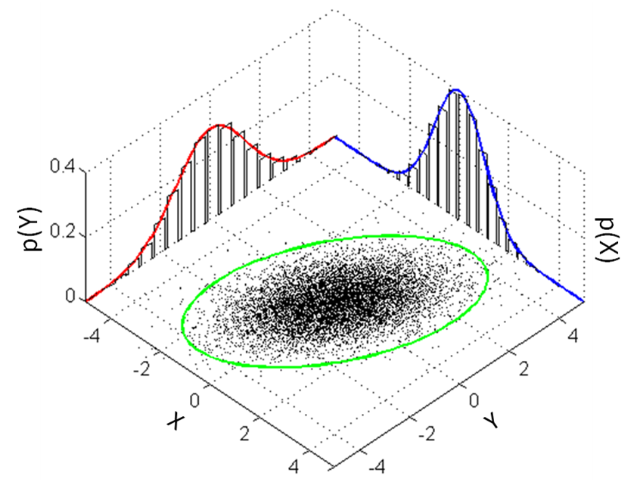
Regression: Bivariate normal with some correlation

Slide 83
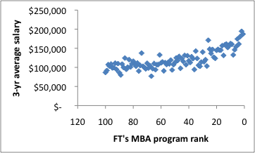
Regression: Example 1
What do you see?
And more importantly, do you see anything wrong with this set-up for a simple regression purpose?

Slide 84
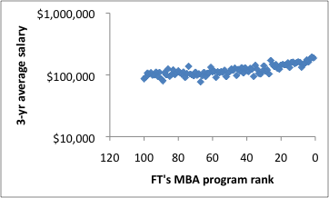
Regression: Example 1
Do you see anything wrong with this set-up for a simple regression purpose?
Yes, because even if a relationship or fit seems directionally correct, this is not a linear relationship.
One axis can be log transformed, but not both.
Note that if one were to do both anyway, the regression mathematics would again change.
Also of issue is that the ranking variable is uniformly distributed, and not normally distributed.

Slide 85
Regression: Example 2
What’s wrong, if anything, with this set-up?

Slide 86
Regression: Example 2
What’s wrong, if anything, with this set-up?
Data was not linear.
Actuarially guaranteed benefit data could be partitioned based upon monthly benefit level.
We can see the potential to examine other relationship, such as transforming both of the axes.
Note that not all partitions here were equally strong from regression stand-point.

Slide 87
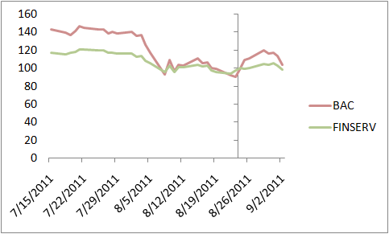
Regression: Example 3
What’s wrong and what’s good, if anything, with this set-up?
Is there is an outlier, where is it?

Slide 88
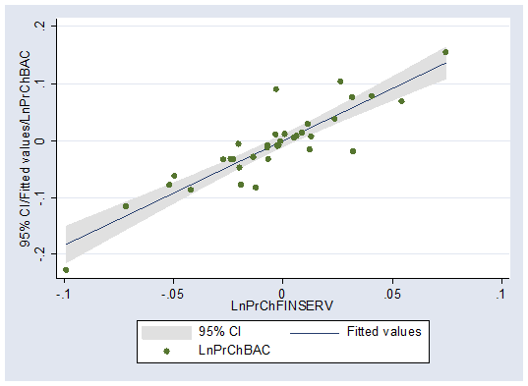
Regression: Example 3
What’s wrong and what’s good, if anything, with this set-up?
If there is an outlier, where is it?
Comments would include there is no clear independent variable.
Assuming there was independence between these variables, then the regression would show an outlier otherwise not seen in the multiple time series chart below.
So technically this bottom right chart is a bivariate time-series analysis, so note that the delta log approach here is estimating steady changes from an exponential stock price trend. In other words, we have not looked (in the upper right chart) at absolute indexed price differences, but the relative ones.
Also on the border of a significant number of data for regression analysis.

Slide 89
Regression: Problem 13 Question
What’s wrong, if anything, with suggesting there’s larger loans for larger loan count packages?

Slide 90
Regression: Problem 13 Solution
What’s wrong, if anything, with suggesting there’s larger loans for larger loan count packages?
We can log both both variables.
But still there is heteroscedasticity.
Let’s decompose the dependent relationship relationship further, by separating out the interactive scaling factor of:
gross amount
= # of loans*typical amount.
Doing so we see the relationship completely fall apart, and invert.
Hence this is an inappropriate data set to perform regression analysis with.

Slide 91
Regression: The mathematical relationship
A linear regression expresses the relationship between two variables in the following manner:
y = f(x)
= β₀ + β₁x + ε
Where y is the dependent variable, and x is the independent variable.
And β₀ and β₁ are intercept and slope parameters, respectively.
Finally ε is the random error term, normally distributed (so mean of zero), for what remains unexplained in this probabilistic model.
If there is independence of the dependent variable after modeling for the value of the independent variable, then the error term (ε) should an identical random normal variables. Recall out bivariate assumption.
We will discuss later how the best fit line does not include the ε term because that has zero expectation.
How do we capture a mathematical expression that fits the best line?

Slide 92
Regression: Orthogonal
The residual error here is defined as the perpendicular difference between the actual data and the predicted value (i.e., estimated).
We show a basic line with a low:
|residuals| and residuals²
We also capture the square of the residual errors as well.
Sample Residual Residual²
-$0.5, -$1.5 -(√2)/2 ½
-$1.5, -$0.5 (√2)/2 ½
-$0.5, $0.5 (√2)/2 ½
$1.5, $0.5 -(√2)/2 ½
$0.5, $1.5 (√2)/2 ½
Sum (√2)/2 2.5
Note, another line could have further zeroed out |residuals|, and the residuals² would also decrease only slightly to 2.4.

Slide 93
Regression: Orthogonal/Linear
Try the same exercise, but this time with the line we take the linear (or vertical) residual errors and errors².
Sample Residual Residual²
-$0.5, -$1.5 -1 1 .0
-$1.5, -$0.5 1 1.0
-$0.5, $0.5 1 1.0
$1.5, $0.5 -1 1.0
$0.5, $1.5 1 1.0
Sum 1 5.0

Slide 94
Regression: Linear
We now change the estimated regression line. Try the same exercise of calculating the linear (or vertical) residual errors and errors².
Sample Residual Residual²
-$0.5, -$1.5 -1.4 1.9
-$1.5, -$0.5 0.2 0.0
-$0.5, $0.5 0.6 0.4
$1.5, $0.5 -0.5 0.2
$0.5, $1.5 1.1 1.2
Sum 0 3.7
Note that despite better than the earlier slides on Residual, this is less effective versus orthogonal on Residual².
It still remains a popular mechanism due to the linear algebra approach of having least-squares, when this mathematics was invented in early 20h century, pre-computers.
Keep this 3.7 number as reference for later.

Slide 95
Regression: A repeat of the main learning ideas from prior 3 illustrations
In a linear regression, we are selecting the best line as that which minimizes the sum of squared (vertical) errors. This is termed SSE.
That whole regression approach is therefore sometimes termed least-squares approach.
Leaving aside the small sample (not good in general but needed for allowing stronger mathematical thinking focused on the data dynamics ), which of the previous charts do this?

Slide 96
Regression: So what are the mathematics of squared errors, then?
Recall our regression equation:
y = β₀ + β₁x + ε
Now given an intercept β₀, variations of the regression can be seen in three interconnected components.
We can see this using this rearranged equation for residual error:
y – β₀ - β₁x = ε

Slide 97
Regression: Problem 14a Question
Cov(X,Y)
=E[(X-x_{avg})(Y-y_{avg})]
What is (σ_{Y})², Cov(Y,Y), and Cov(X,Y) of purple data?
What is (σ_{X})², Cov(X,X), and Cov(X,Y) of green data?

Slide 98
Regression: Problem 14a Solution
What is (σ_{Y})², Cov(Y,Y), and Cov(X,Y) of purple data?
Cov(Y,Y)
= E[(Y-y_{avg})(Y-y_{avg})]
= E[(Y-y_{avg})²] = E(Y²)-E(Y)²
= 2/3-0 = (σ_{Y})²
Cov(X,Y)
= E[(Y-y_{avg})(Y-y_{avg})], since Y=X and X=Y
= Cov(Y,Y) = 2/3 (or 4/6)
What is (σ_{X})², Cov(X,X), and Cov(X,Y) of green data?
Cov(X,X) in green
= Cov(X,X) in purple, or same Cov(Y,Y)=2/3
= (σ_{X})² in green
Cov(X,Y)
= E[(X-x_{avg})(Y-y_{avg})]
= [(-1-0)(.5-0.5)+(0-0)(1-0.5)+(1-0)(0-0.5)]/3
= [(-1)(0)+(0)(0.5)+(1)(-0.5)]/3
= [0+0-0.5]/3 = -1/6

Slide 99
Regression: Multiplying by sample size, we expand the math relationship here
The variations are shown below:
y – β₀ - β₁x = ε
SS_{yy} - β₁SS_{xy} = SSE

Slide 100
Regression: Mathematics of squared errors, continued.
The variations are shown below:
y – β₀ - β₁x = ε
SS_{yy} - β₁SS_{xy} = SSE
SS_{yy} = Cov(y,y)*n = (σ_{y})²*n = SST
β₁SS_{xy} = β₁Cov(x,y)*n = SSR
β₁ = SS_{xy}/SS_{xx} = Cov(x,y)/(σ_{x})²
Note that SST-SSR=SSE, or SST=SSR+SSE

Slide 101
Regression: Problem 14b Question
Error minimization is related to correlation:
y – β₀ - β₁x = ε
SS_{yy} - β₁SS_{xy} = SSE
Given SST=SSR+SSE, minimizing the error² (SSE or MSE) is equivalent to maximizing SSR.
The calculation for Pearson correlation rho, ρ (or R or r if using non-Greek symbols for samples):
ρ = Cov(x,y) / [σ_{x}*σ_{y}]
Simplify the SSR/SST ratio (sometimes termed coefficient of determination) using the equations we have discussed earlier, and show how it is related to correlation.

Slide 102
Regression: Problem 14b Solution
Simplify the SSR/SST ratio using the equations we have discussed earlier, and show how it is related to correlation.
SSR/SST
=(β₁SS_{xy})/SS_{yy}
= [Cov(x,y)/(σ_{x})² * Cov(x,y)*n]/[(σ_{y})²*n]
= [Cov(x,y)²*n] / [(σ_{x})²(σ_{y})²*n]
= Cov(x,y)²/(σ_{x})²(σ_{y})²
= [Cov(x,y)/(σ_{x}*σ_{y})] ²
= ρ²

Slide 103
Regression: More on correlations
The simple correlation we have studied is the parametric Pearson, or ρ.
Another correlation formula takes the same calculation, but not on the raw data.
Instead the non-parametric Spearman looks only at the list-wise sorted data (in orange).
In our case here, the Pearson and Spearman results are 0.5 and 0.6, respectively. So here, similar to some extent, but often times slightly different.
For non-parametric, there is also a Kendall’s correlation τ, but that too we only need to know exists, but not responsible for the mathematics behind it.
Data | X_{raw} | X_{rank} | Y_{raw} | Y_{rank}
1 | -0.5 | 2.5 | -1.5 | 1
2 | -1.5 | 1 | -0.5 | 2
3 | -0.5 | 2.5 | 0.5 | 3.5
4 | 1.5 | 5 | 0.5 | 3.5
5 | 0.5 | 4 | 1.5 | 5

Slide 104
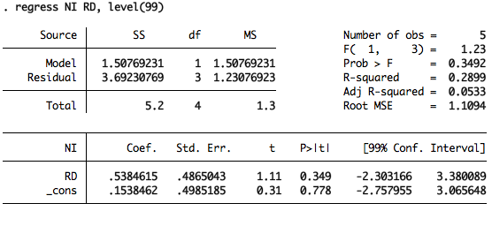
Regression: How does this regression output report look?
Recall the 3.7 SSE?

Slide 105
Regression: Additional regression output notes
Adjusted-ρ² penalizes ρ² for mostly the number of independent variables.
Can turn negative and meaningless.
An unbiased estimator of error² is:
SSE/(total degrees of freedom - k)
Since we consume two total degrees of freedom in the estimation of β₀ and β₁ (which goes into SSR),
Total degrees of freedom is therefore reduced by k=1, so (n-1)-1 will term this above equation above as MSE.
The standard error is √MSE.
There are k, degrees of freedom for just the SSR component. Where there is one k per independent variable.
And total degrees of freedom=n-1.

Slide 106
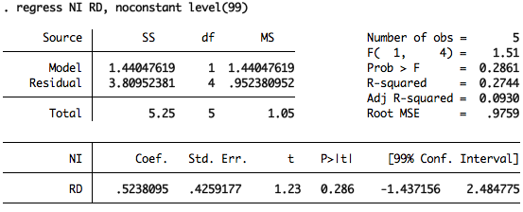
Regression: Now, about those β’s
Both β₀ and β₁ have estimation errors associated with them.
On an aside, for β₁, the error coefficient is partially inversely proportional to n-1-k, or n-2 here.
And S_{XY}/√(SS_{XX}):
S_{XY}/√(SS_{XY}/β₁)
= S_{XY}/√[(SSR/β₁)/β₁]
= 1.1/√[(1.5/.54)/.54] = 0.49
The t-values reveals the statistical significance of the β₀ and β₁.
Significant t values on β₁ in particular (e.g., >2.5 or <-2.5) indicates a relationship with dependent variable
Insignificant t values, on the other hand, could be difficult to assess.
Insignificant t values on β₀ could be dealt with by removing β₀ altogether

Slide 107
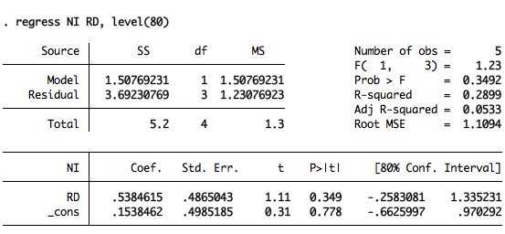
Regression: Now, the F-test
The F value is MSR/MSE.
Or 1.5/1.2 = 1.2.
It suggests the general ratio of the regression deviations to the error deviations.
And of course a F>1 suggests the deviations from the former is greater than the errors from the latter. This would be desirable in a highly explanatory model.
Insignificant t values on β₁ in particular (e.g., >2.5 or <-2.5) invites the hypothesis of whether β₁ is simply 0.
Recall SST-SSR=SSE.
So SS_{yy}-β₁SS_{xy}=SSE. When β₁~0, SS_{yy}~SSE, as SSR~0.
MSR/MSE =[~0/k]/[SSE/(n-k-1)]
=[~0*(n-k-1)]/[SSE*k]
~0/MSE
An F-test shows the probability distribution of this small valued F, given β₁=0.
Oddly, some statistical software do not alter the F critical value nor test when the CI changes.

Slide 108
Regression: F-test versus critical level, continued

Slide 109
Multivariate regression: F-test for 1,4 and two paths to get there from 1,3
29%

Slide 110
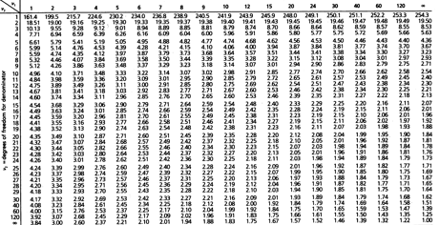
Regression: Critical F-score from table (5% level)

Slide 111
Multivariate regression: Calculation of adjusted-ρ², and relation to total d.f.
Adjusted-ρ²=1-(1-ρ²)[(n-1)/(n-k-1)]
Now what happens as k (number of independent, explanatory variables) increases?

Slide 112
Multivariate regression: Problem 15 Questions
Assuming a ρ² of 0.2899 regardless, including for a 3,1, then what would the adjusted-ρ² be for a 4,1?
Assuming a ρ² of 0.2899 regardless, including for k=1, then what is the largest n for adjusted-ρ²>0?
Also how would one interpret an adjusted-ρ² of -1? What about 0?

Slide 113
Multivariate regression: Problem 15 Solutions
Assuming a ρ² of 0.2899 regardless, including for a 3,1, then what would the adjusted-ρ² be for a 4,1?
Adjusted-ρ² ~ 1-(1-ρ²)[(n-1)/(n-k-1)]
~ 1-0.71[5/4]
~ 0.11
Flat, though slightly higher than 3,1 where it was 1-0.71[4/3] = 0.05
Assuming a ρ² of 0.2899 regardless, including for k=1, then what is the smallest n for adjusted-ρ² comfortably above 0?
0 < 1-(1-ρ²)[(n-1)/(n-k-1)]
-1 < -0.71[(n-1)/(n-2)]
1.4 > [(n-1)/(n-2)]
1.4n - 2.8 > n – 1
0.4n > 1.8
n > 4.5, or at least 5
In other words, a lower n (e.g., 2,1) or a larger k (e.g., 1,2) would have likely been negative.
Also how would one interpret an adjusted-ρ² of -1? What about 0?
This is not good, but not related to a negative ρ. Perhaps that there is colinearity from pure dependency among the two variables, but otherwise see the comments below for a 0 adjusted-ρ².
For 0, we might want to investigate with a less desirable test when you have something other than B₀ and B₁, which is the F-test if some coefficient β_{m} is appropriate or removal of β₀.

Slide 114
Multivariate regression & correlation/causation: computer module
Upload text datafile “NIReg20140502.txt”.
Create a R program to create regression NI(RD).

Slide 115
Multivariate regression: We formally intro. as extension of linear regression
A linear regression expresses the relationship between a dependent variables and multiple independent variables in the following manner:
y = f(x_{m})
= β₀ + β₁x₁ + β₂x₂ + β₃x₃ + … + β_{k}x_{k} + ε
So this is where k=m>1.
And β₀ remains the intercept, while the β_{m}’s are the slope parameters.
The independent variables must not only not be purely dependent of the dependent variables, but none of the dependent variables can not purely depend on one another. Otherwise doing so will lead to multi-colinearity.
If there is independence of the dependent variable, after accounting for the modeling from the independent variables, then the error term should again be an identical random normal variable.

Slide 116
Multivariate regression: Linear
What if we introduced another explanatory variable, such as goodwill.
And let’s say that goodwill happens to track R&D, except for the data where R&D equals $1.5.
There goodwill will instead equal $1.0, or hence closer to the current estimated line in red.
What would be the impact on the F value, and on β₁?

Slide 117
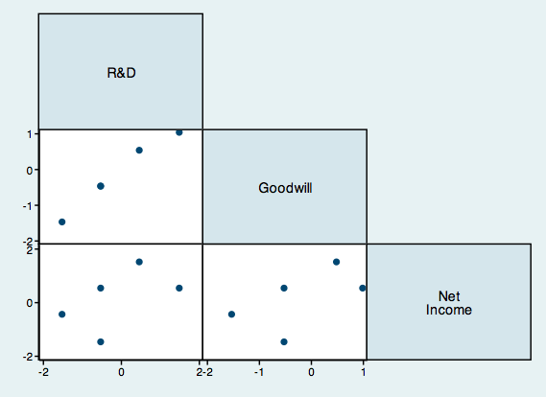
Multivariate regression: To answer this we must be clear. We have colinearity.

Slide 118
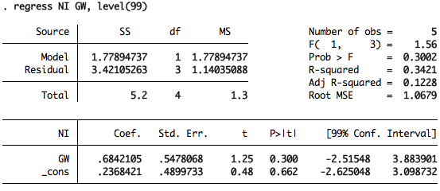
Multivariate regression: From multiple linear regressions…

Slide 119
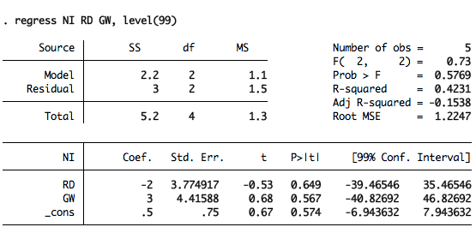
Multivariate regression: … to one multivariate. But now look at those β_{m}’s
Strong ρ².
But adjusted-ρ² and F scores are weaker.
Goodwill soaks up a higher β₂,
While R&D sees β₁ fall erroneously into negative territory
And both those β_{m}’s have weaker t-statistic.
While β₀ now gobbles up a stronger t-statistic.

Slide 120
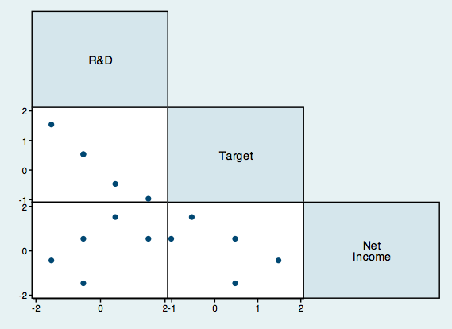
Multivariate regression: What if we have a new variable Target = –GW?

Slide 121
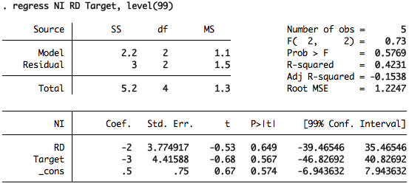
Multivariate regression: β_{m}’s are just partially correctly
But otherwise the same characteristics as before (where we had GW instead of Target)
Strong ρ².
But adjusted-ρ² and F scores are weaker.
Target gets correct negative sign in front of β₂,
But R&D still has β₁ with a weaker t-statistic.
While β₀ now gobbles up a stronger t-statistic.

Slide 122
Multivariate regression: Summary of ρ’s={~1,~1,~1}, and ρ’s={~1,~-1,~-1}

Slide 123
Multivariate regression: Now what would ρ’s={~-1,~-1,~-1} look like? Animation of x,y,z axes. http://statisticalideas.blogspot.com/2013/06/correlated-trivariate-normal.html

Slide 124
Multiple regression: Multiple and partial correlations
The ρ² we’ve discussed so far, before adjustments, is also used directly for multiple correlation.
Say net income (NI) is correlated to R&D (RD) and goodwill (GW), jointly. But say we want to isolate the correlation of GW, after accounting for the impact of RD on both NI and GW. This would be the partial correlation.
So we are looking at the correlation between:
[NI – (NI_{estimated from RD})], and
[GW – (GW_{estimated from RD})]

Slide 125
Multivariate regression: Nonlinear and interactive term
Other mechanisms to express a multivariate regression other than in simple linear form:
y = β₀ + β₁x₁ + β₂x₂ + β₃(x₂)² + … + ε
[square frame price related to (length of frame)²]
y = β₀ + β₁x₁ + β₂x₂ + β₃(x₁x₂) + … + ε
[retained earnings is related to (age)*(earnings)]

Slide 126
Multivariate regression: Introducing the “dummy” variable
Instead of goodwill, we instead introduced a new variable that is a dummy indicator variable for data at R&D $1.5.
For example, say this is a unique data, not dependent (or exogenous) of the fact that it has a lower than expected net income relative to R&D. This regression strategy prevents falsely over-mining the results.
For example, say it is the only company that is based overseas, while the other companies as in the US. And R&D amortization accounting is different under overseas accounting rule.
We may not know this overseas accounting impact on net income, so we apply a “1” value for this dummy variable, while “0” for the other data.
Be careful since the dummy is just an indicator (e.g., 0,1) and hence not normally distributed.
What would be the impact on the F value and on β₁?

Slide 127
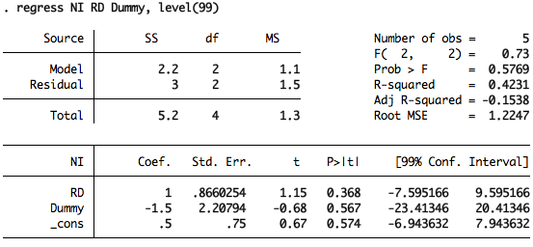
Multivariate regression: But now look at those β_{m}’s
Ignoring the small sample size temporarily, we still have a good ρ².
And still adjusted-ρ² and F scores are weaker (incidentally these tend to match w/ GW). Shown further below to most likely be a sign of over-fitting.
Dummy is directionally correct with not such a significant β₂ though,
While R&D sees β₁ correct sign again.
And all t-statistics are generally better versus at least the simple regression.

Slide 128
Regression topics: Problem 16 Question
Which regression for effect (e.g., A, or B) is stronger, or are they the same? What would be the statistics to guide you? Note there is no value for Effect A&B.
Is there anything which can be done to enhance your conclusion? And how would one use the F-statistic to assist in the solution?

Slide 129
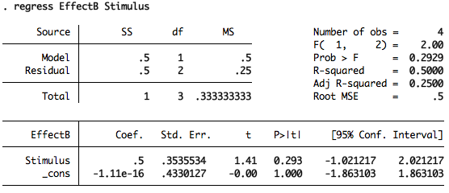
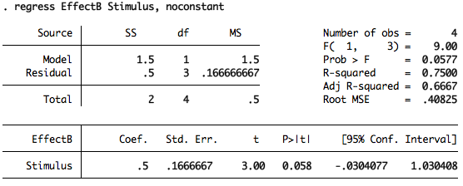
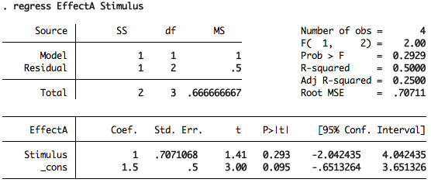
Regression topics: Problem 16 Solution
Orthogonally, both would have the same regression characteristics.
Except in linear regressions, the line flows towards the highest slope combined with with the least squared errors.
So Effect B would have no intercept, and thus a higher F statistic without an intercept.
Of course one could also remove the Effect A model intercept and get a higher F-statistic, but this would be unwise since the cost is a higher standard error and now soaking up of the β₀ coefficient that was most significant.
One lesson here is that the removal of the β₀ could enhance the t and F statistics especially if one has good reason to remove β₀. Also note that the SSR then oddly rises.

Slide 130
Intro clustering: Generally speaking, how many clusters do you see?

Slide 131
Intro clustering: Now what do you see that is different?

Slide 132
Intro clustering: R module
Examine text data file for download from the web portal.
This file replicates the data for the previous data chart
Import this data into R, and perform the cluster analysis for 2 and 4 clusters

Slide 133
Intro clustering: Main points
Optimizes a cluster that are as far apart as can be, while jointly each cluster is tight as can be.
User generally assigns the number of clusters, with some advanced tools that may help on the margin.
Can be applied to a single vector of numeric data, or something more complex including similarities in text structure (outside the realm of general statistics).
Algorithms are imperfect due to random seed of calculation.
While we use smaller data sets to examine the theory in class, try to use the larger data after experimentation to reduce rounding issues in complex algorithms.
Examine results for sensibility.
Final point on analytics is be cautious of interpretations of level of signals, beyond the underlying change in direction (note examples from Challenger, and Google Flu).

Slide 134
Conclusion
It’s been a pleasure discussing the ideas of probability, statistics, and analytics that have been most relevant for industry professionals, as I have seen in recent years.
We leave some time at the end for final thoughts or questions that you have.
Also please complete the course/faculty reviews and submit per the instructions- we have historically enjoyed these and take the feedback seriously.
Do stay in touch, download this presentation anytime from my website, and good luck.

